Slide 1

DR. AWKWARD PRESENTS:
THE BIOCHEMISTRY OF PSYCHEDELICS
& HARM REDUCTION
OR:
“I DON’T FUCK AROUND, BUT WHEN I DO, I DON’T FUCK AROUND”
v1.3 - Updated 06/2024

Slide 2
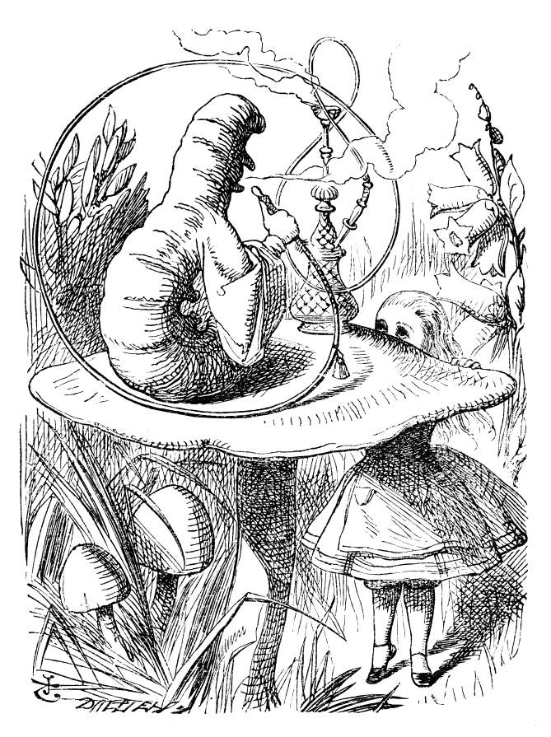
WHO ARE YOU?
What makes you “you”?
What’s the difference between a living and dead person?
If you can take a chemical that changes how you see the world, what does that mean?
How can we make chemical exploration safer?
Let’s find out…

Slide 3
DISCLAIMERS, ETC.
WARNING: THIS PRESENTATION CONTAINS SCIENCE.
Drugs are bad, mkay.
  Use of drugs remains illegal. Thanks Nixon!
  Drugs are dangerous. So is driving a car. Don’t be reckless with either.
I’m not a real doctor; I just play one on TV
  Check with a medical professional and do your own research
Educate yourself!
This information is purely educational. Okay? Okay.

Slide 4
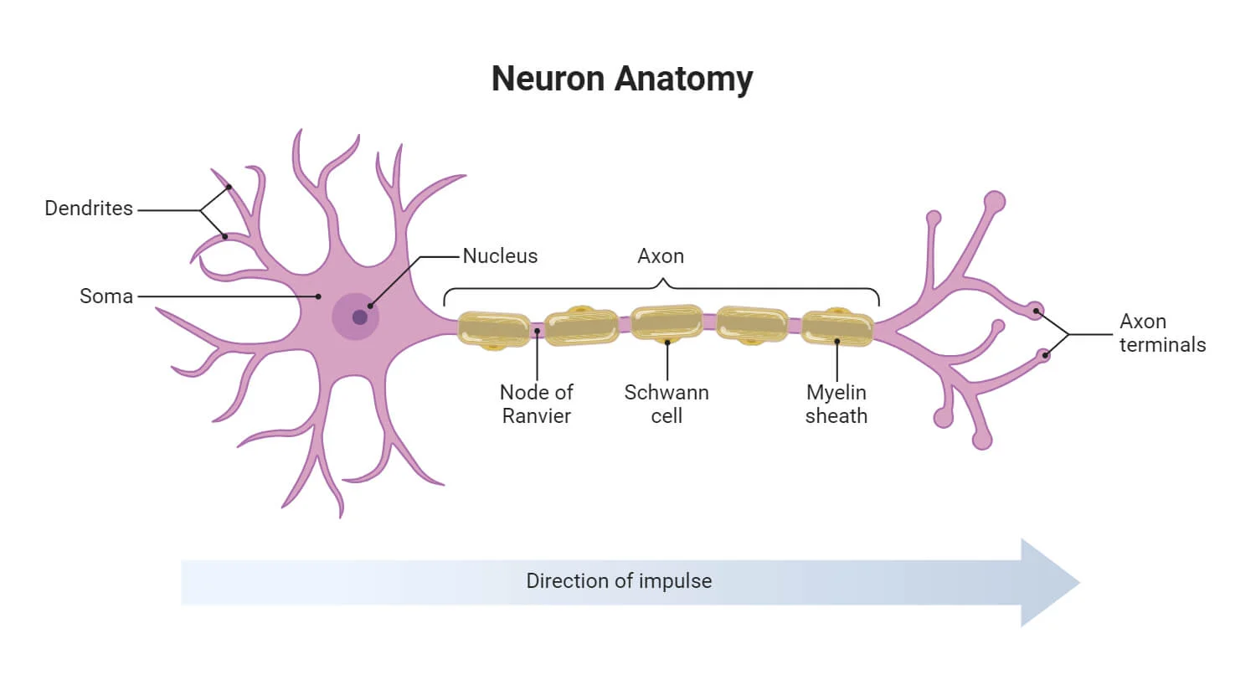
GETTING ON YOUR NERVES

Slide 5
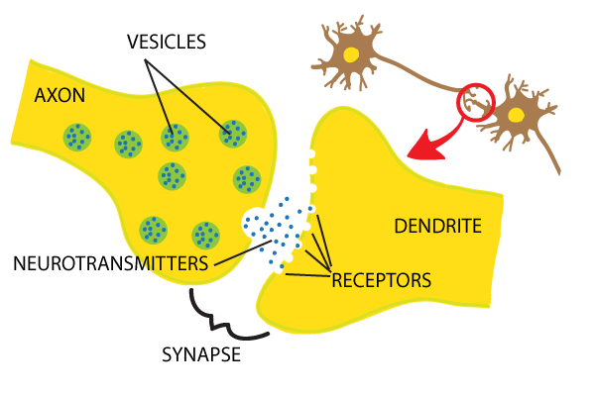
OH SNAP, IT’S THE SYNAPSE
A nerve is stimulated
Signal moves down the axon
Neurotransmitters are released into the synapse
Neurotransmitters plug into receptors in the next cell
Reuptake sucks them back into the first cell
Cleanup!

Slide 6
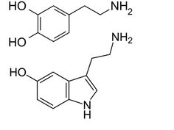
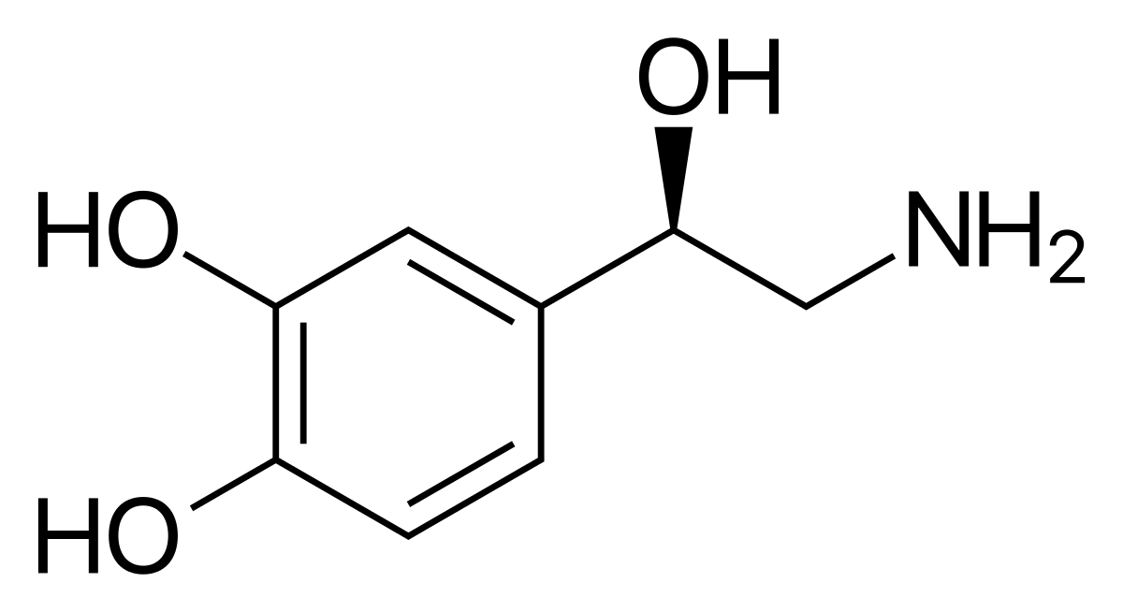
DOPAMINE & SEROTONIN: THE ONLY THINGS YOU LIKE
Dopamine
Your body’s “feel good” reward chemical
Released when you do something good
  Eat a big meal
  Orgasm
  Addiction
Serotonin (5-HT)
Primary chemical of consciousness
Affects your moods and perception
90% found in your gut
Norepinephrine
AKA “noradrenaline”
“Fight or flight” chemical
Produced from dopamine
Yeah, that’s cool, but what about them?

Slide 7
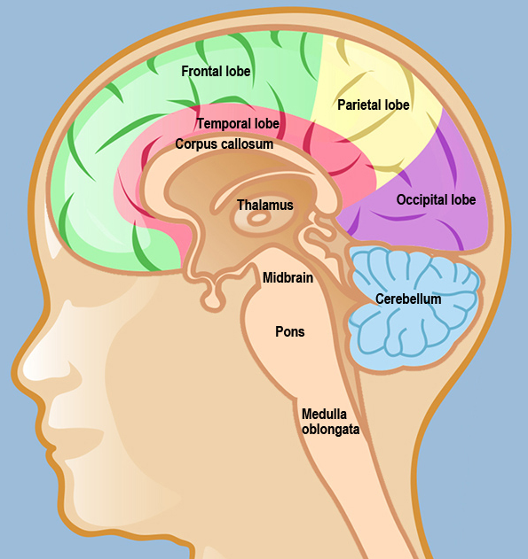
HEADY SHIT
How you experience the world:
Signal comes in through your senses and is filtered by the thalamus (ahh, too much data!)
Signal is processed by the parietal/occipital lobe
Signal is interpreted by the frontal lobe
Request for more info is sent to the thalamus

Slide 8
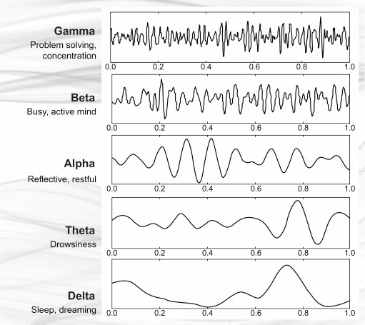
YOU ARE A 40HZ STANDING ELECTRICAL WAVE
DUUUUUUDE….

Slide 9
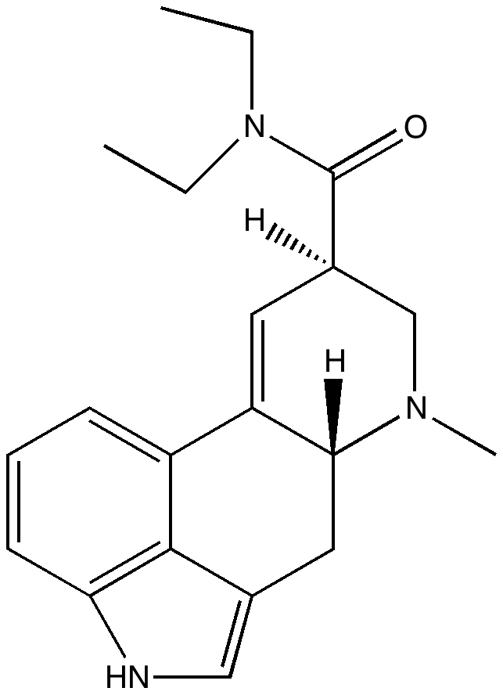
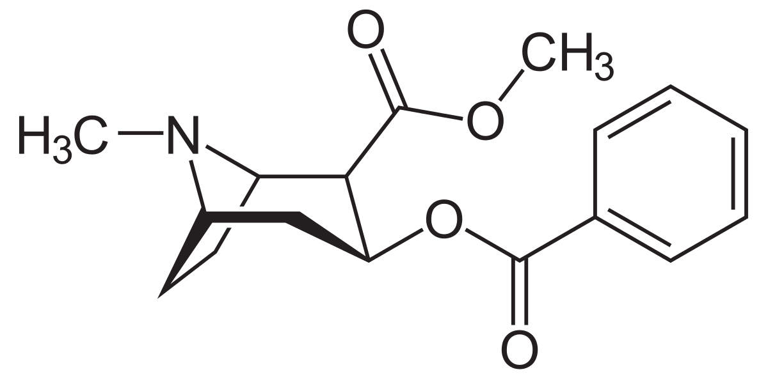
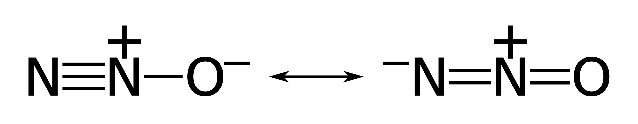
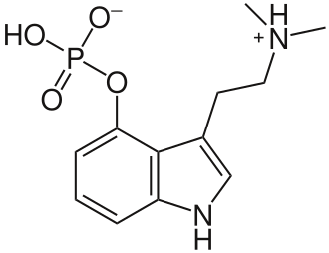
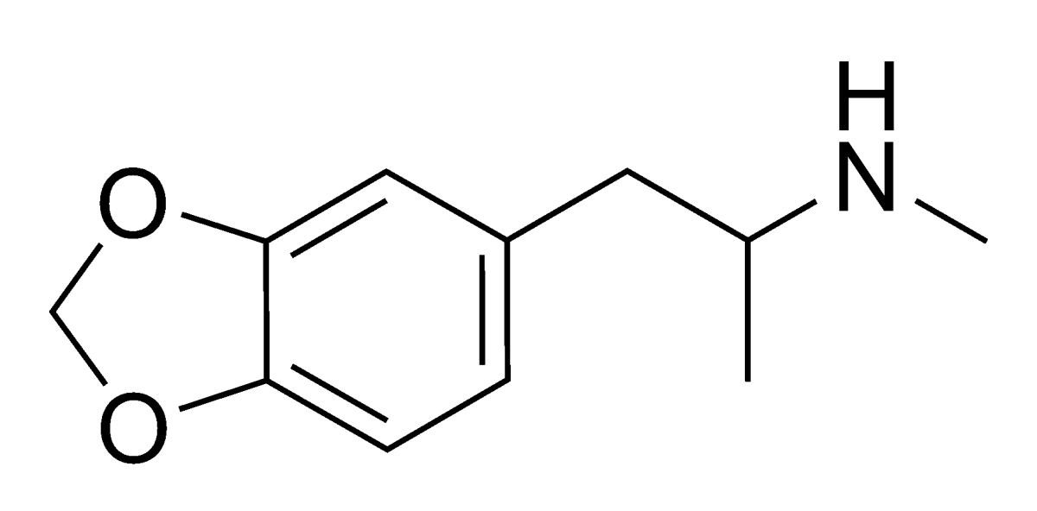
SAY HELLO TO MY LITTLE FRIENDS

Slide 10

MADAM I’M ADAM – MDMA/MDA
MDMA
MDA
X, XTC, Ecstasy, Molly, Rolls, Sassafras, Sass, etc.
Made from Safrole – Sassafras root bark
History
  First synthesized in 1912 by Merck chemist Anton Kollisch
  Looking for substances to stop bleeding for use in WWI
  Mostly forgotten until Alexander Shulgin rediscovered it in the 60s & 70s
  Used for psychotherapy in the 70s-80s
  Became popular in Texas gay clubs in the 80s
  Schedule I in US on May 31st, 1985
  In process for reclassification for Schedule II for PTSD

Slide 11
LET’S GET THE PARTY STARTED
MDMA/MDA are “triple reuptake inhibitors” and flood the synapse with all three of your favorite things!
Make proton pumps run backwards for reuptake

Slide 12
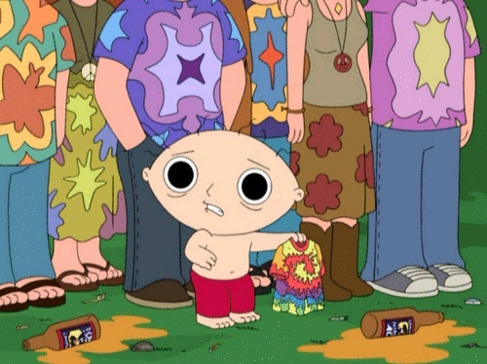
DOES ANYONE HAVE SOME GUM?
Good Effects:
Empathogenic effects
Psychedelic effects
Stimulant effects
Bad Effects:
Jaw clenches
Eye twitches
Temperature flux
Increased heartbeat
Difficulty urinating
“Rave shits”
Comedown
Depression
Loss of appetite
Loss of clarity - “E-tarded”
“Suicide Tuesday”

Slide 13
VITAMINS: THE DIFFERENCE BETWEEN YAY AND UGH
6 hours before:
200mg Magnesium Glycinate
100mg Na-R-ALA
~3g of Ginger
1-3 hours before:
200mg Magnesium Glycinate
100mg Na-R-ALA
~3g of Ginger
1000mg Vitamin-C
100mg Grape Seed Extract
500mg ALCAR
400mg EGCg
500mg L-Tyrosine
100mg CoQ10
30 mins before:
2x Tums/Rolaids
Every 2 hours after dosing:
100mg Na-R-ALA
200mg Magnesium Glycinate
100mg Grape Seed Extract
You don’t have to write this down. I have cards with this on it.

Slide 14
THE IMPORTANT ONES
  Ginger - ~3g.
    Get about 1.25 inch/30mm diameter piece (American half-dollar sized)
    Doesn’t matter what kind (Candied, fresh, ginger beer, GinGins)
    Get the kind with actual ginger, not “ginger ale” or “ginger flavor”
    Changes your body’s metabolism (moderates CYP450) to prevent MDMA -> MDA
    Shown to reduce neurotoxicity and hangover
  Magnesium Glycinate – 200mg
    Usually 2 vitamins. Check the bottle
    Get Magnesium Glycinate, not Mg Citrate, unless you love pooping
    Prevents jaw tightness and eye twitches
    Helps with the “clear” signal in your synapse
  Na-R-ALA /Sodium Alpha Lipoic Acid - 100mg
  ALCAR/Acetyl-L-carnitine -500mg
  Vitamin C -1000mg
    Get Na-R-ALA, not ALA!
    Better together
    Helps protect the “grey matter” of your brain
    Strong antioxidant
    Helps prevent “hangover” and loss of mental clarity

Slide 15
YUM, VITAMINS FOR DINNER
Grape Seed Extract – 100mg
    Powerful antioxidant
L-Tyrosine/NALT – 500mg
    Dopamine precursor
    Helps make sure you have an appetite the next day
EGCg/Green Tea Extract – 400mg
    Powerful antioxidant
    Helps you with inability to urinate
CoQ10 – 100mg
    Helps your brain regulate and reduces toxicity
Tums/Rolaids
    Reduces acidity in your stomach
    Helps you need to take a lower dose

Slide 16
…AND AFTER
  That night:
    Melatonin – 10mg (Yes, this is a lot of melatonin)
      Helps you get restful sleep after you’ve depleted your serotonin
      Powerful antioxidant
  Next few days:
    5-HTP & EGCg
      ALWAYS TAKE 5-HTP WITH YOUR EGCg!!!
      Don’t take your recovery vitamins too early.
    Vitamin B-6 & Magnesium Glycinate
      Help your body produce serotonin
      Will give you vivid and weird dreams

Slide 17
FUCK VITAMINS, I’M ALL NATURAL
  Nutritional recovery
    Ginger - Neuroprotective
    Eggs & Cheese – Everything your body needs
    Pumpkin seeds/”pepitas” – Sell them at gas stations. Eat the shells, too.
    Water, water, water – flush out all the toxins
    Fish – Good source of fatty acids
  Behavioral recovery
    Get lots of rest
    Cut back on drinking. You’ve done enough brain damage for a while.
    Weed/CBD is actually good for you
    Wait a month between experiences
    Seriously, though, think about the vitamins

Slide 18
NEVER NEVER NEVER NEVER NEVER NEVER
Seriously, think twice before you do these things:
Mix MDMA/MDA with:
    Cocaine – Both of these drugs raise your blood pressure. You can have a heart attack, even if you’ve never had heart problems.
    MAOIs – Serotonin Syndrome. You don’t want it.
    DXM – Cough medicine – Inhibits your sweat reflex and drives up your body temperature
    Opiates/Ritonivar – Broken down by the same chemicals in your body, can cause an overdose of both drugs
    Speed/Meth/Other stimulants – Raise your blood pressure
    Most antidepressants – Prozac, Lexapro, Celexa. Not dangerous, but prevent the effects.
  Take your recovery vitamins too early.
    Don’t take 5-HTP until you’re done
  Pay attention to your body temperature, but…
  Don’t go nuts with water
    Drink when you think you need it

Slide 19
ALWAYS ALWAYS ALWAYS ALWAYS ALWAYS
  Buy from a “reputable source”
    Know where it’s coming from. Don’t take candy from strangers.
  Test your shit
    Buy a test kit – www.dancesafe.org
    Know how to spot the difference between MDMA/MDA/Analogs/Fakes/Bath salts
    Know how to test for Fentanyl, since now we can’t have nice things.
  Give yourself a break
    Wait at least a month, preferably 3 or 4 between experiences

Slide 20
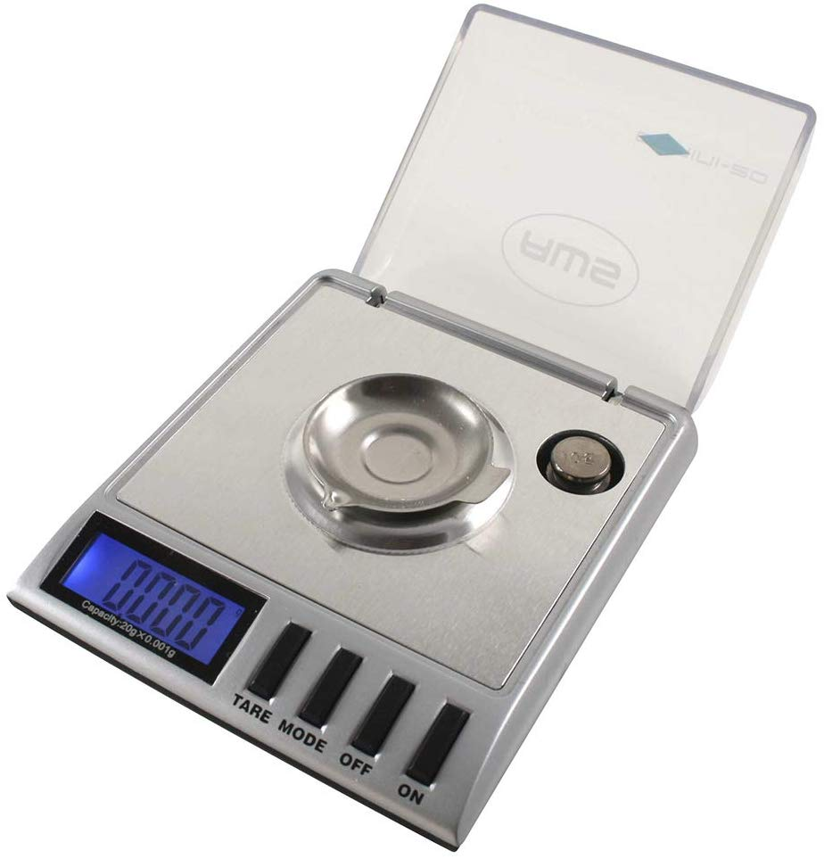
ANCHORS A-WEIGH
    Get a scale
      Eyeballing milligrams is about impossible
        Every batch is going to be different density
        Finger dipping is a great way to take way too much
      Get a milligram scale that goes to 0.001g (jewelry scale, gunpowder scale)
        About $20 on Amazon
        Put a weight on the scale when using it. Scales are most accurate in the middle of their range.
    Lower your dose
      75-100mg is a reasonable dose
      In research settings, “halving down” has shown to produce the most pleasant effects
      Start with a medium-low dose (80-100mg)
      Each hour or two, take about half of the previous dose
        Example: 100/50/25/15 = 190mg total OR 80/40/20/10 = 150 mg total

Slide 21
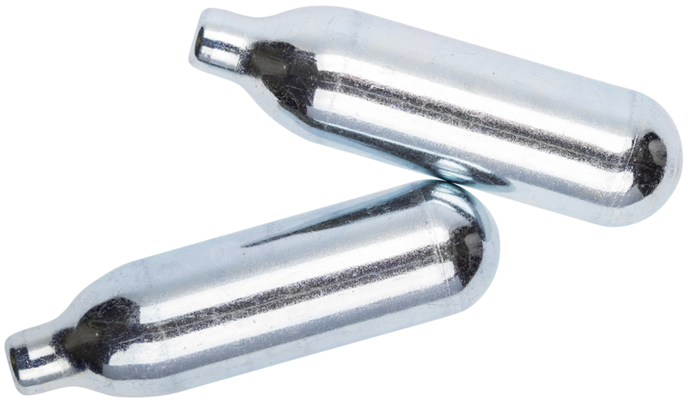
WHIPPIT GOOD
Nitrous Oxide
Nitros, Whippits, Nos, Noz, Hippie Crack, Chargers, Loons, Nangs

Slide 22
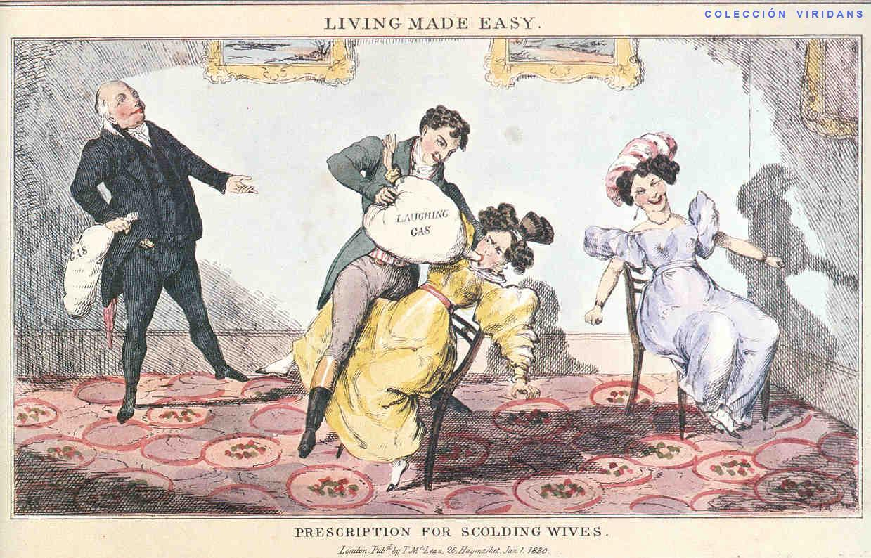
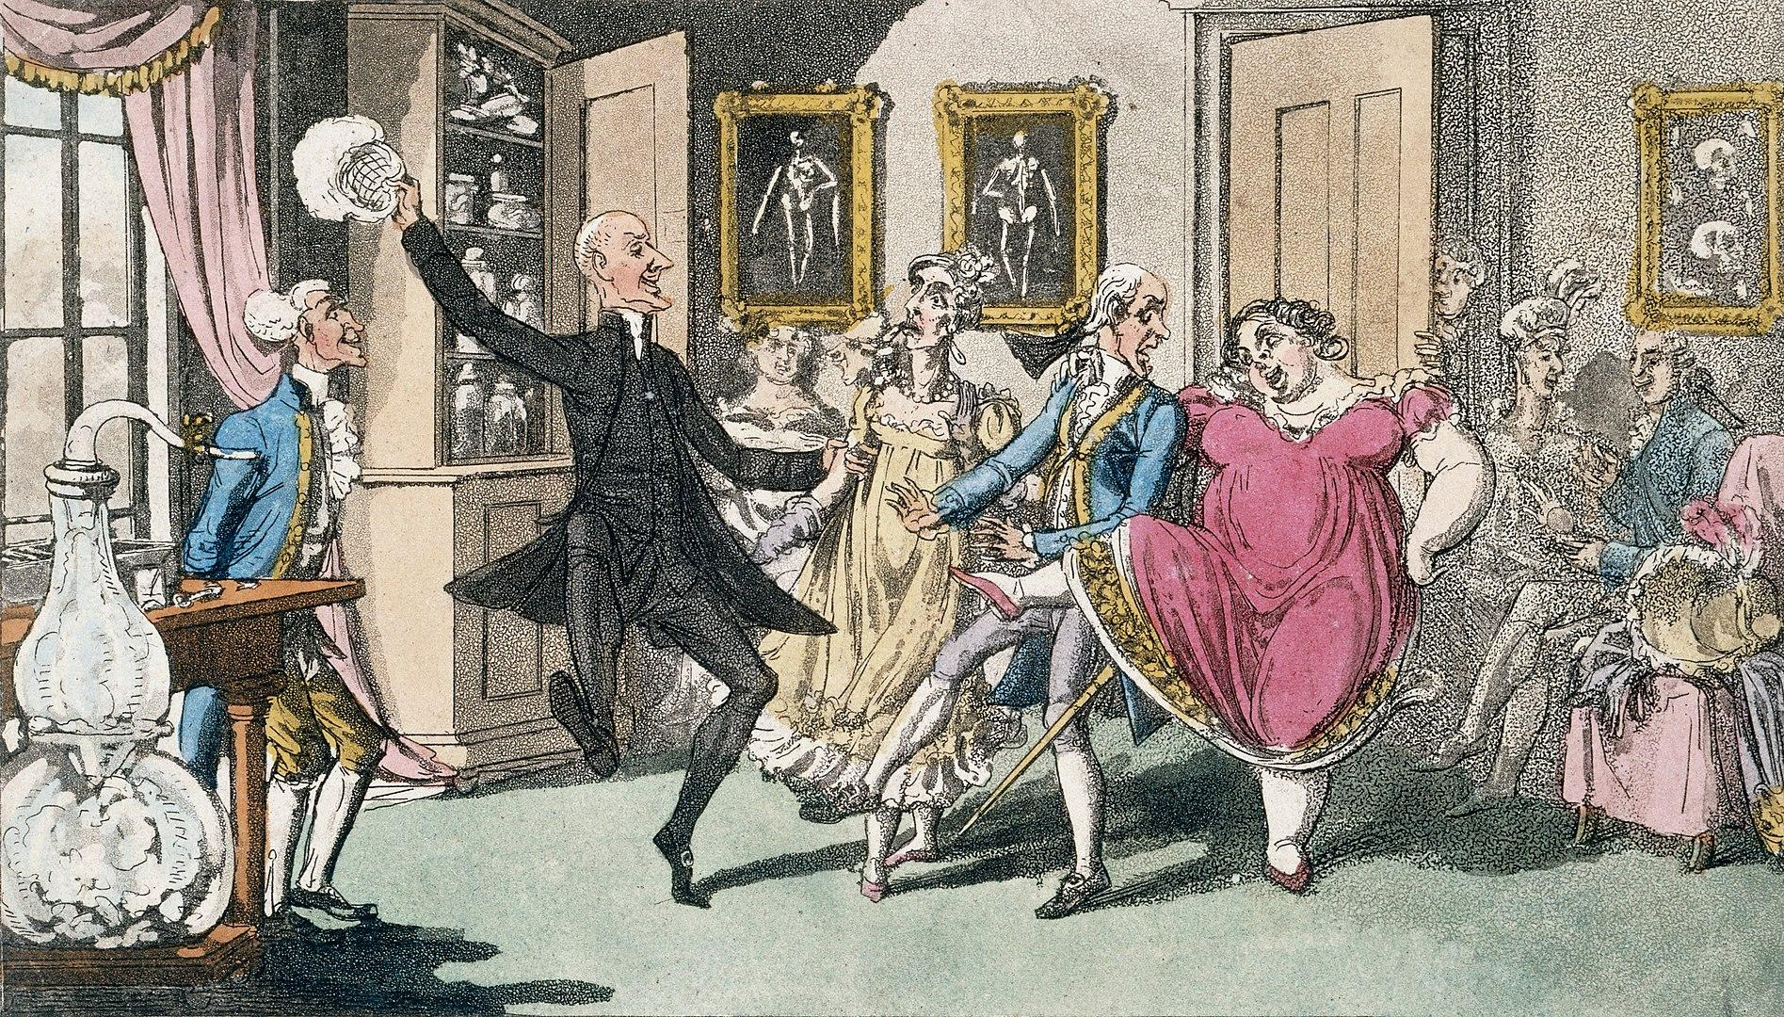
I’D LIKE A CARTON OF PHLOGISTICATED NITROUS AIR CHARGERS, PLEASE
Discovered in 1772 by chemist Joseph Priestly who called it “phlogisticated nitrous air”
By 1799, “laughing gas parties” were the rage among British upper class. Due to the difficulty and expense in producing it, it remained a secret of the upper class.
In 1863, Gardner Quincy Colton became the first to introduce nitrous oxide for general dental anesthetic use in New York City, treating over 25,000 New Yorkers over 3 years, and introducing the general public to the drug

Slide 23
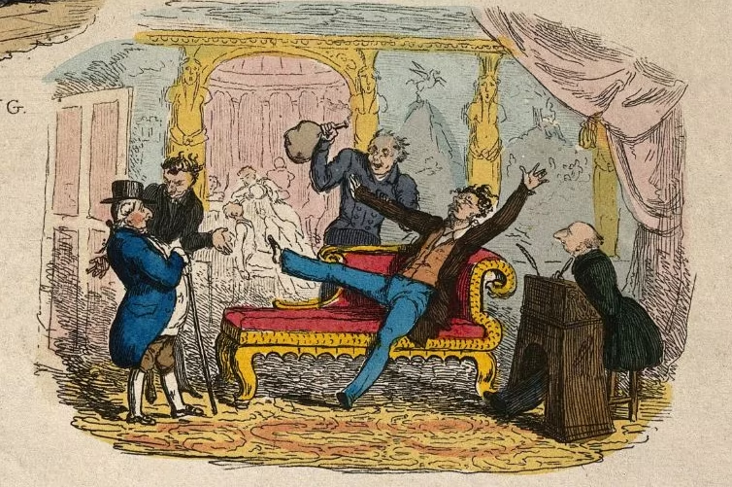
HIPPIE CRACK
Nitrous Oxide is a dissociative, causing auditory hallucinations (nangs)
Nitrous Oxide has complex metabolism, and stimulates dopamine pathways, causing euphoria and causing addictive behaviors, aka finishing the whole box
Due to its similarity to nitric acid, it causes vasodilation of smooth tissue aka a boner

Slide 24
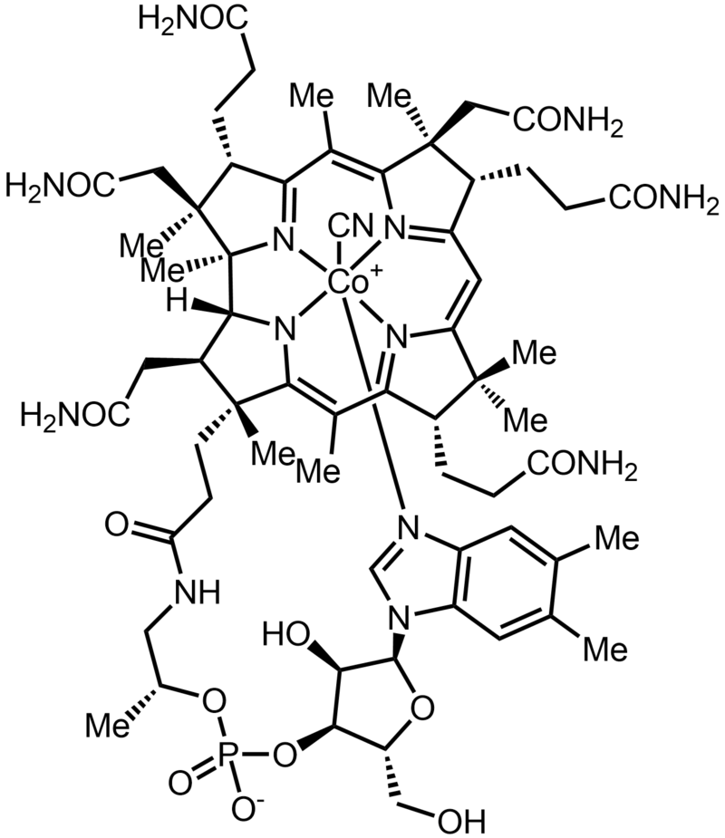
VITAMIN B-12
Largest and most structurally complex vitamin
In literally every cell of your body
Only produced by bacteria and archea
Unusual due to the charged cobalt atom in the middle of the “flower”
Found in milk, meat, shellfish, tempeh, nori, or supplements
Important neuroprotective
Used in energy and myelin production
Yeah, so?
The charge in Nitrous Oxide strips the cobalt from B-12, inactivating it, and causes damage to myelin.

Slide 25
GETTING FAT
The myelin sheath insulates the signal as it travels down the neuron. When the sheath gets damaged, the signal degrades, causing neurological damage.

Slide 26
PROTECT THAT SHEATH, YO
Supplements
  Vitamin B-12 (Cyanocobalamin) – 500 mcg – Replace lost B-12
  L-Methionine – 500 mg - reduces toxicity from B-12 loss
Mix some air in – much of the toxicity is actually from hypoxia (lack of oxygen)
  Blue lips, nails, toes (cyanosis)
  Nitrous Oxide is exhaled mostly unprocessed (0.004% metabolized), but the oxygen from it gets consumed
Give yourself some time between experiences
  Most healthy people have reserves of B-12
  If you’ve had an experience, give it some time to build back up

Slide 27
WHAT A LONG, STRANGE TRIP IT’S BEEN
First synthesized by Albert Hoffman
  November 16, 1938
First intentional trip
  April 19th, 1943 (Bicycle Day)
Used throughout the 60s
Made illegal on Oct 24th, 1968
Produced from ergot alkaloids
  Salem Witch Trials
Active in micrograms (thousandths of milligrams)
1 recorded death
  Circus elephant injected with 1kg (1 billion doses)
LSD-25
L, Acid, Lucy, Tabs, Doses

Slide 28
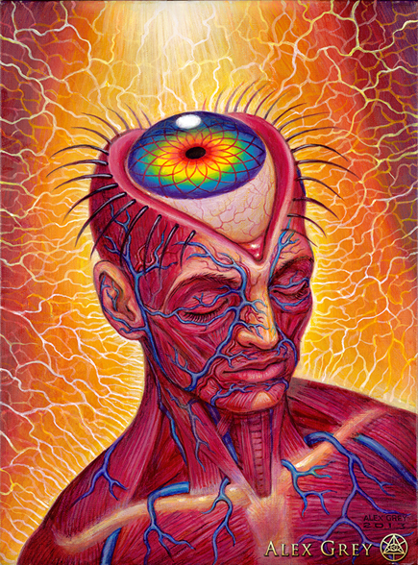
THIS IS YOUR BRAIN ON DRUGS
How you experience the world:
LSD tightens up your thalamus, allowing less actual input in
Your brain compensates by increasing your “brain speed”
Your brain “fills in the gaps” using your thoughts, memories and emotions

Slide 29
DON’T BELIEVE EVERYTHING YOU HEAR
LSD isn’t physically dangerous, but it can be psychologically stressful
Only 1 fatality in history (elephant)
Not particularly reactive with other drugs
    Don’t mix it with Tramadol (increases your risk for seizure) or stimulants (increases your chance of a “bad trip”)
    Can react unpredictably with certain antipsychotics and the conditions they treat
There are a lot of myths about it:
    “The guy who took 100 hits and now he thinks he’s an orange/glass of orange juice”
    “There’s Strychnine in acid”
    “It stays in your spinal fluid”
    “If you take acid more than 3 times, you’re legally insane”
    “It causes genetic mutations”
    “If you get caught selling/doing/giving someone acid, they can charge you with attempted murder”
    “I heard about a guy who was on acid and jumped off a cliff/put a baby in the oven/stared at the sun and went blind/voted in the last election/etc.”
    Nope.

Slide 30
PACKING FOR YOUR TRIP
Preparation
    Test using Ehrlich Test for 25i-NBOMe or other analogs - http://dancesafe.com
Set
    Your personal state of mind
    Avoid using psychedelics when you’re under stress: physical, emotional or psychological.
      Some latent psychological conditions may be worsened or triggered by any psychedelic.
    Use the minimum you need. You can always take more, but you can’t take less.
    Set a timer when you start, so you know how long it’s been.
    Consider having Xanax standing by - “parachute pill”
      Avoid sleeping pills - Ambien is too weak to overcome LSD (or any other drug)
Setting
    The environment around you
    Be around people you trust, in a comfortable setting
    Have a plan for a place you can be if you need to chill out for a while
  Before, During and Afterwards
    Choline
      Helps relieve symptoms of mental exhaustion
      Alpha-GPC supplements
      Naturally in meat, dark greens and cauliflower
  Flashbacks
    Form of PTSD, not actually related to the chemical

Slide 31
STRAP ON YOUR SKIS
Cocaine
Coke, blow, snow

Slide 32
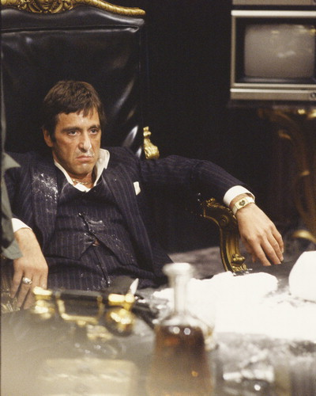
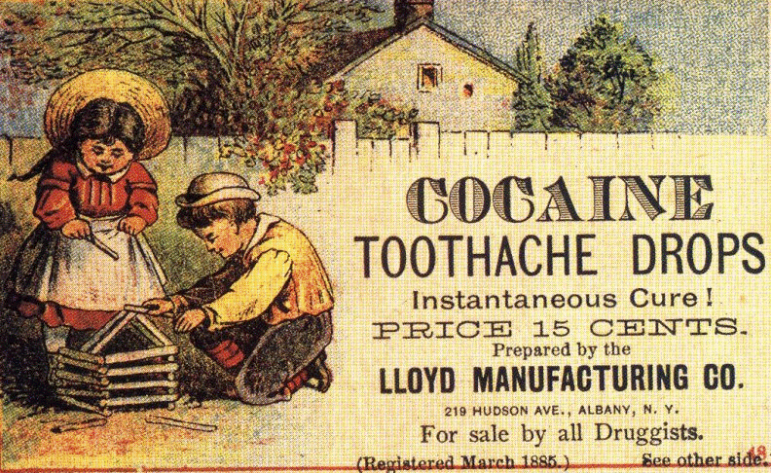
YOU’VE GOT SOMETHING ON YOUR NOSE
Derived from the Coca plant
  Same plant as Coca-Cola
Used traditionally in South/Central America since Pre-Columbian times
First isolated in 1855
2nd most consumed drug after cannabis
  14-21 million people/year globally
Used as a patent medicine

Slide 33
AGAIN AND AGAIN AND AGAIN
Cocaine works primarily on your dopamine receptors (D₁ & D₂)
It taps your body’s natural addiction center
Stressful for your heart
Broken down by your liver, not filtered by your kidneys
    Causes havoc if you mix it with things, e.g.:
      Cocaine + alcohol = cocaethylene, a more cardiotoxic compound
  VERY DANGEROUS TO MIX
    Don’t mix with stimulants, MDMA/MDA, alcohol, psychedelics, or pretty much anything else
    If you’re going to do it, it’s best to just do one thing at a time

Slide 34
FIRST CUT IS THE DEEPEST
  Average purity - 20-30%
  Often “cut” with other substances
    Vitamin C
    Sugar (Dangerous if injected)
    Aspirin
    Caffeine (speedy)
    Lidocaine, procaine, benzocaine (numbing)
    Levamisole (“enhances the rush”)
      Cattle dewormer that causes low white blood cell count
  Chemicals added to make it flake (hairspray), pass “bleach test” or numb your gums
  Best indication of purity?
    BUY A TEST KIT
    Smell - Hard to fake

Slide 35
OW, MY HEAD
Aftercare:
  Wash out your nose
    Cocaine constricts your blood vessels and can kill the tissue in your nose
    Use a Neti pot or just be gross and blow your nose in a hot shower
  N-Acetyl Tyrosine or just L-Tyrosine
    Dopamine precursor
    Found in cheese

Slide 36
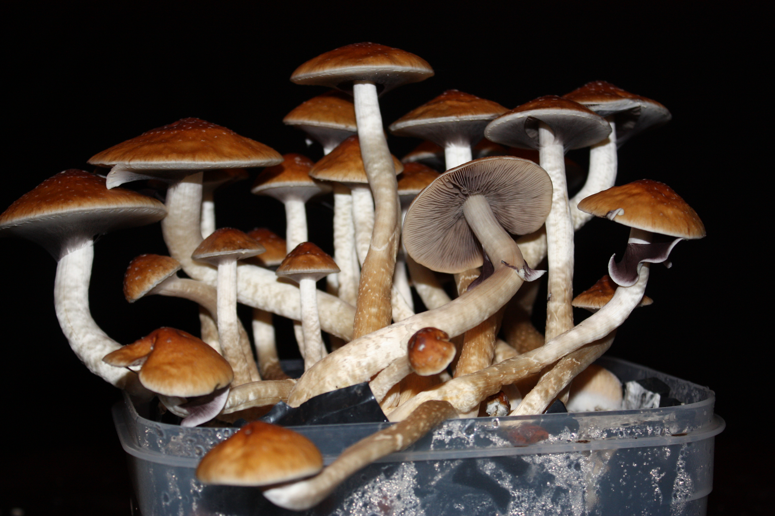
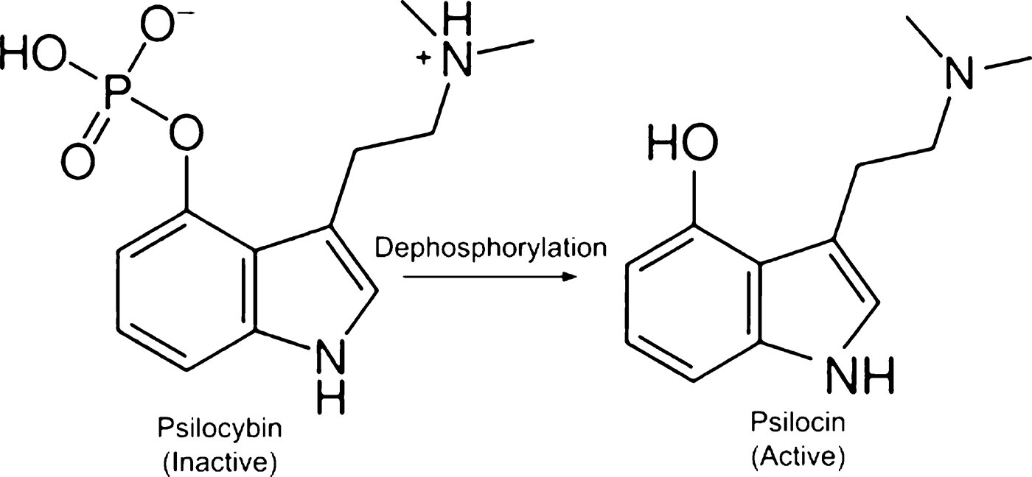
WHY NOT, I’M A FUN GUY- PSILOCIN/PSILOCYBIN
Mushrooms, Shrooms, Caps, Mushies, Boomers, Cubes
The active chemicals in “magic” mushrooms
Grown and used since prehistory
  Used extensively by Mesoamerican Native peoples and across Europe
  Used from prehistory to modern times
    Part of sacred rites in Native American peoples (Mexico/Mesoamerica)
    In the West, use was sporadic and often accidental

Slide 37
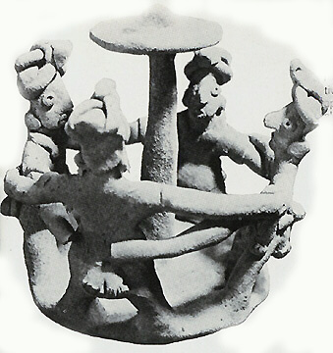
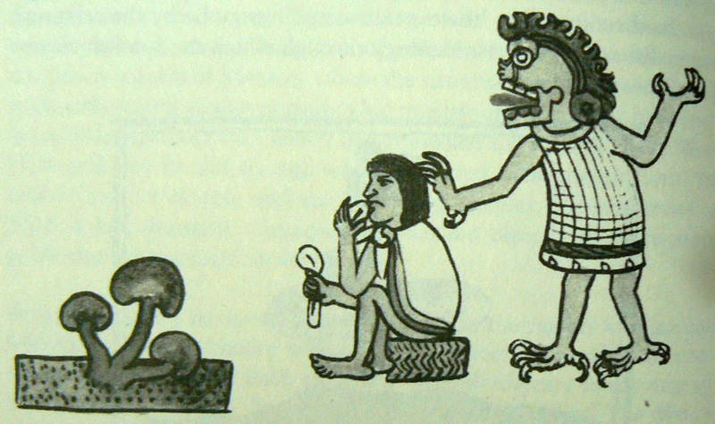
LITTLE FLOWERS OF THE GODS
Psilocybin Mushrooms were considered sacred emanations of the divine by pre-Columbian Native Mesoamerican peoples.
Mushrooms were part of Mayan and Aztec religious, divinitory, ritual and recreational use. They were consumed to consecrate events (such as the crowning of a king), to produce visions, or just because it’s fun to do mushrooms.
In Nahuatl, they were referred to as “Teonanácatl” - “divine flesh”
After the defeat of the Aztecs, the Spanish declared them to be a tool of the devil (surprise), and forbade traditional use of any hallucinogens or “pagan idolatry.” Squads of priests were assigned to forcefully stamp out native use in Mexico.
Naturally, use continued through oral tradition and without knowledge of the Spanish. As writing about them was forbidden, academic knowledge of mushrooms was lost until 1938– Prior research assumed that “Teonanácatl” referred to peyote.

Slide 38
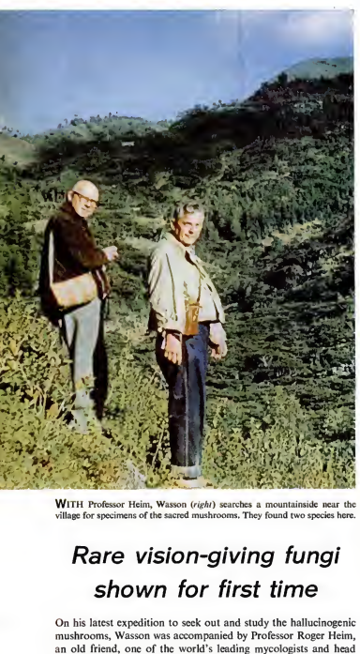
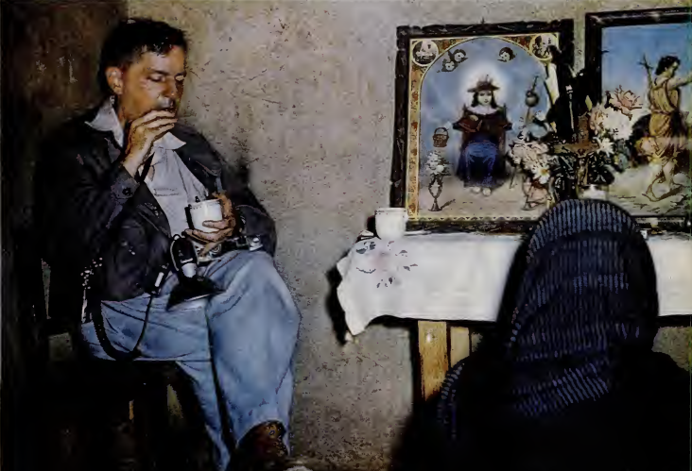
WASSON, WASSOFF
In 1955, R. Gordon Wasson (then the VP of J.P. Morgan, now known as Chase Bank) and Valentina Wasson became the first known European Americans to actively participate in an indigenous mushroom ceremony.
They published many articles about it, including in Life magazine (May 13, 1957), inspiring a new generation of researchers
In 1958, famous chemist Albert Hoffman identified psilocybin/psilocin as the active chemicals in these mushrooms.

Slide 39
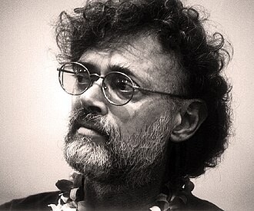

IT’S A SWINGING SHINDIG
Inspired by the Wassons, new researchers emerged:
Timothy Leary travelled to Mexico to follow in the footsteps of the Wassons with Richard Alpert (better known as Ram Dass), founding the Harvard Psilocybin Project when he returned in 1960.
  The Harvard Psilocybin Project famously conducted research with prisoners (recidivism dropped below 40%), and with divinity students (who had profound spiritual experiences).
Terence McKenna, after reading the Wasson’s article, began focussing on mushrooms after his mother’s death in 1970 led him and his brother Dennis to Mexico. He later became a celebrated ethnobotanist, author, and speaker, famous for his breakthroughs in cultivation and his spiritual theories about the role of mushrooms in our evolution.

Slide 40
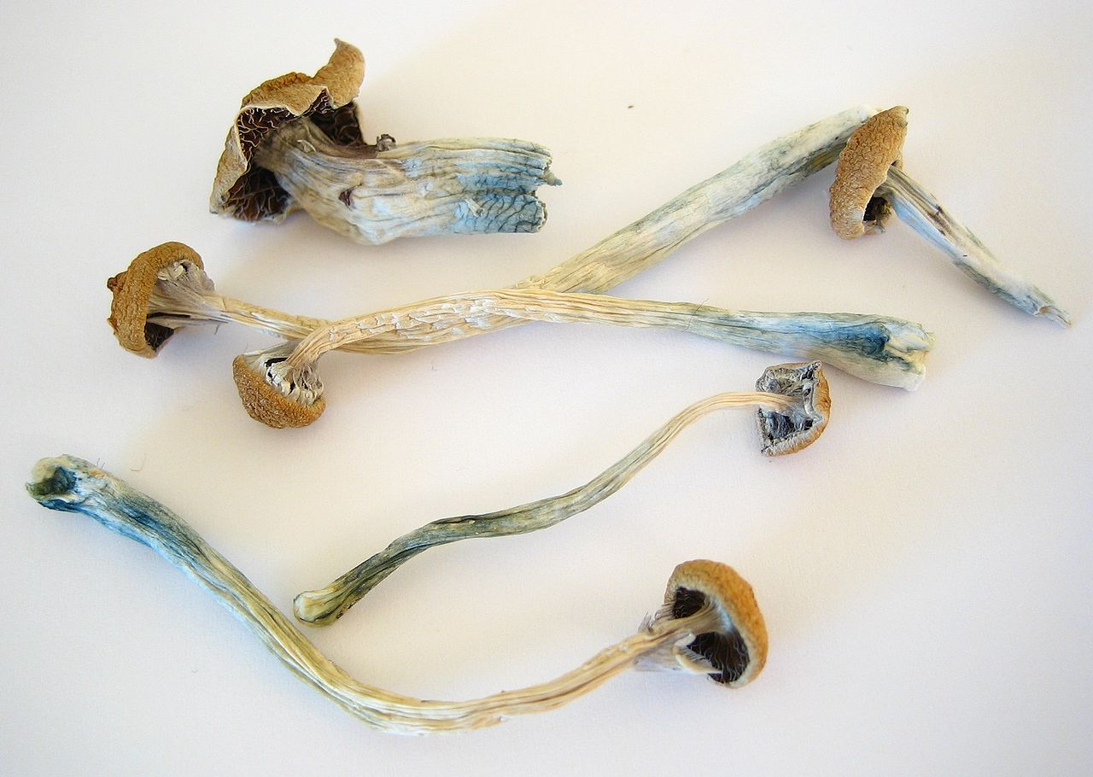
ALL GOOD THINGS…
Psilocybin and Psilocin were made federally illegal, along with LSD, on October 24th, 1968.
The UN Convention on Psychotropic Substances bans psilocybin, BUT does not ban the mushrooms containing them, due to pressure from Mexico.
  Spores of Psilocybin mushrooms are also exempt, for “microscopic study”, providing a loophole for their use.
  Using “San Antonio’s Technique” for growing mushrooms in rye grain (publicized by Terence McKenna), underground growth and use continue to modern day.
Attitudes are changing: Oregon, Colorado, California and Washington, DC have re-legalized possession!
Studies are underway to examine Psilocybin for end-of-life patients.

Slide 41
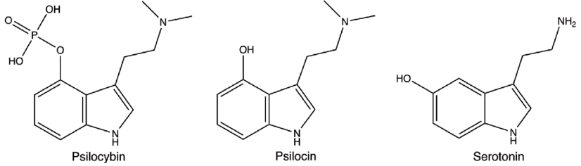
“ACID PUTS YOU IN THE DRIVER SEAT, BUT MUSHROOMS TAKE YOU FOR A RIDE”
Psilocybin/Psilocin are structurally similar to Serotonin, causing many of its effects.
It binds with high affinity to serotonin receptors, directly impacting your consciousness.
Compared to LSD:
Psilocybin is approximately 1/100th the potency on a weight-basis, and lasts about half as long.
Psilocybin has limited direct impact on your dopamine system
Psilocybin induces alterations in glutamate balance, causing subjective feelings of “ego death”

Slide 42
STILL TASTES LIKE ASS, THOUGH
Mushrooms are natural, and their potency may vary.
Psilocybin is less toxic than caffeine: it would take 3.7 lbs of fresh mushrooms to be physically dangerous.
0.25g of dried mushrooms is a threshold dose, 1.5g-2.5g is a standard dose, 3.5+ is a strong dose, 5g is a hero dose.
Give it time! It takes 30 minutes on an empty stomach, and much longer on a full stomach. Patience!! Wait 2 hours before taking more.
Soaking your mushrooms in lemon juice (“tek”) will convert psilocybin to psilocin, making the mushrooms feel stronger, but shorter in duration.
Mushrooms aren’t particularly reactive, but can still interact with other substances:
Alcohol can act as a weak MAOI inhibitor and can make mushrooms feel stronger. It can also increase nausea. YMMV.
If you are a tobacco smoker, mushrooms will hit you harder. Tobacco smoke decreases the activity of MAO. If you’re having a bad time, that next cigarette might be a bad idea.
LSD & 2-CB have cross tolerance with psilocybin. If you do one, it will take 24-48 hours for you to feel the full effect of the other, so space them out if you’ll be enjoying both of them.
LSD, MDMA, 2-CB and Marijuana don’t have particularly strong interactions with mushrooms, and are often called “flipping”

Slide 43
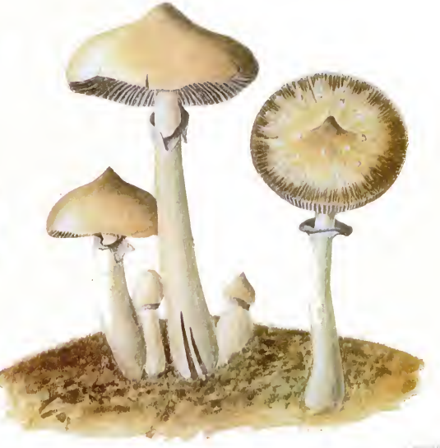
SET AND SETTING!
Mushroom experiences can be overwhelming:
Set/setting!!! - Don’t do mushrooms if you’re in a bad headspace
Make sure you have a safe place to be.
Set a timer when you drop, if you experience time dilation
If you find yourself getting “lost in introversion,” get up and move around.
Have a “sitter” that you trust.
Mushrooms taste bad. That’s 10,000 years of evolution telling you not to eat poison. Often, people will come up with crazy ideas of how to make them taste better. They’re all terrible.
The most common side effect that people try to mitigate are the digestive effects of mushrooms, caused by ingesting the non-digestible mushroom solids:
Nausea/Vomiting
Gas/Bloating
Stomach Cramps/Diarrhea
Indigestion/Burping up nasty mushrooms/etc.

Slide 44
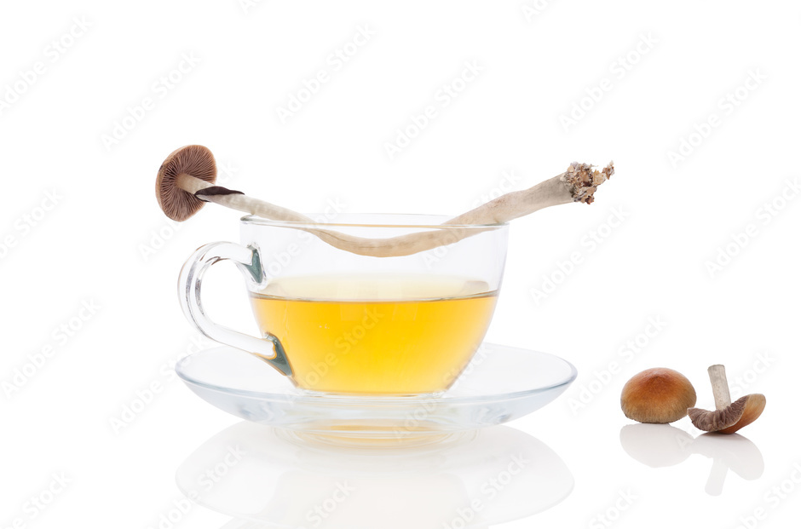
TEA TIME
One way to avoid most of the digestive effects of mushrooms is to make mushroom tea:
Grind up your mushrooms and put them in a tea bag or coffee press. Add peppermint, if you have any. (Other possible additives: ginger, orange)
Boil water (1 cup per person), and pour over your mushrooms. Immediately start boiling more water.
Add a squirt of lemon juice if possible. (This helps convert the psilocybin to psychoactive psilocin, and will give you a better experience)
Let steep for 10-15 minutes or until water is golden yellow. Be patient!
Serve, and immediately add new water to your mushrooms. This generally makes 2-3 cups off the same grounds.
Compost the grounds, explore the universe, repeat.

Slide 45
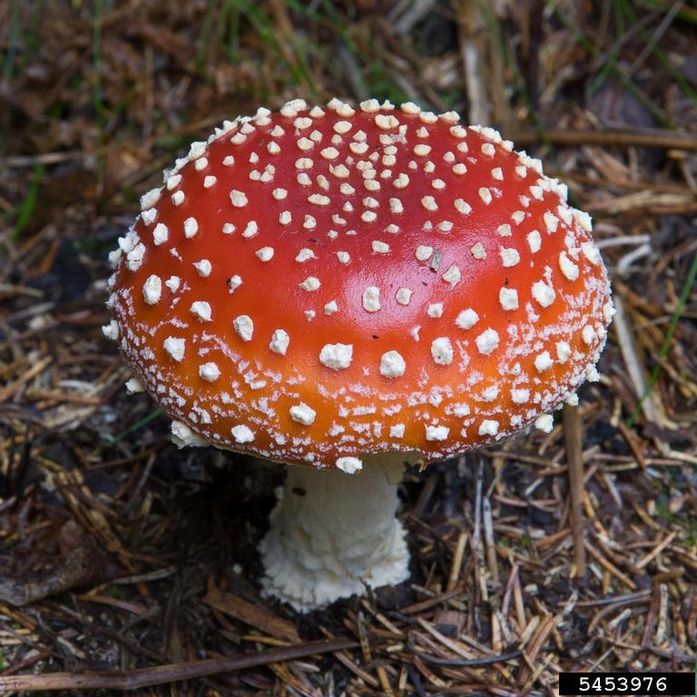
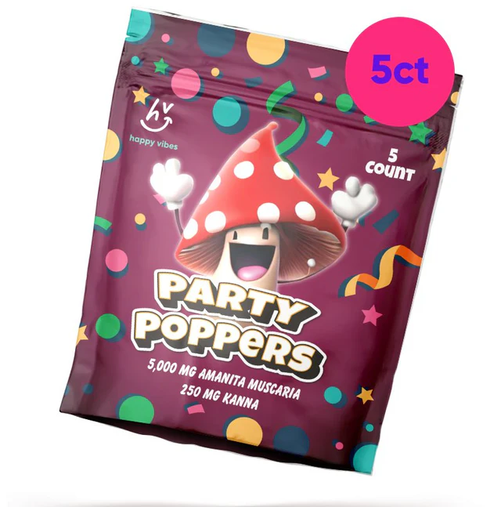
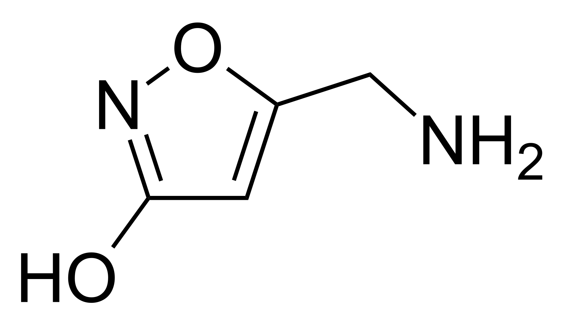
ALL MUSHROOMS ARE NOT THE SAME
Amanita Muscaria (Fly Agaric) is also a psychedelic mushroom, with rich tradition of human use, but contains no psilocybin!
Muscimol (the primary psychoactive ingredient) will definitely not be the same experience you were expecting.
Considered a “deliriant” rather than a “psychedelic.”
Intoxicating and dreamy vs trippy
Can cause issues with overdose
It’s often found in “legal” mushrooms sold at smoke shops. Know the difference!
≠
Muscimol
Psilocybin

Slide 46
BEFORE YOU GO…
“Harm reduction” doesn’t mean “safe”
    Educate yourself!
  Your body is different than anyone else’s in the world. Listen to it.
  “Drugs are like tools. Not every tool is for every job and some tools you’ll never need at all.”

Slide 47
RESOURCES
Copies of this lecture- http://www.conspiracycamp.com
Vaults of Erowid (Experience notes) – http://www.erowid.org
DanceSafe (Buy testing kits here) – http://www.dancesafe.org
RollSafe – http://www.rollsafe.org
MAPS – Multidisciplinary Association for Psychedelic Studies – http://www.maps.org/
Hey kids, take a picture of this slide!

Slide 48

QUESTIONS, COMMENTS, RECIPES?

